Slide 1


Converting a MS excel spreadsheet to .csv
.csv stands for comma separated values

Slide 2

Converting excel to .csv
Heads up: This is just a plain text format with some general rules for structure.
General specification of .csv
Header: Usually first line
Rows: separated by line breaks “\n” (enter)
Columns: separated by commas “,”
However in this case we used semi colons “;” because of the decimal values.
Attention!: Sometimes textual columns may be surrounded by quotes “ text “

Slide 3
Converting excel to .csv
Header (Column labels)
General specification of .csv
Header: Usually first line
Rows: separated by line breaks “\n” (enter)
Columns: separated by commas “,”
However in this case we used semi colons “;” because of the decimal values.
Attention!: Sometimes textual columns may be surrounded by quotes “ text “
Column 1
Column 2

Slide 4
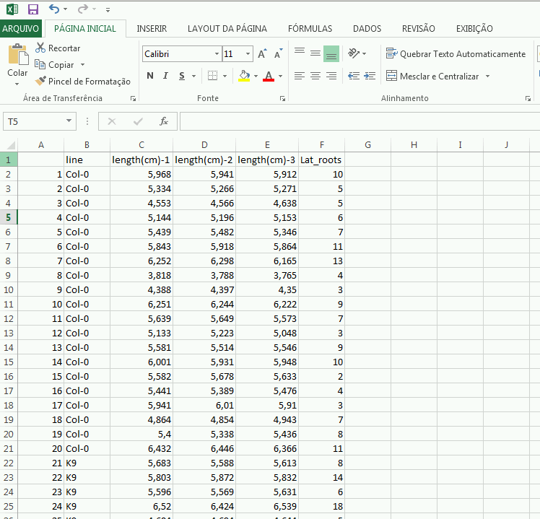
Converting excel to .csv
In MS excel:
Click on File

Slide 5

Converting excel to .csv
Save as(1) > Computer(2)
2
1

Slide 6
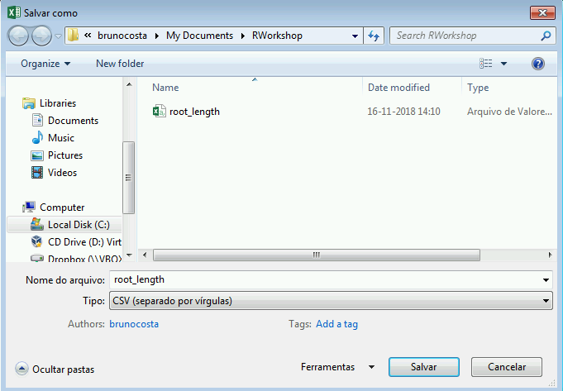
Converting excel to .csv
Choose location to save new file.
Choose name for the new file.
Select type: CSV
Click save
1
2
3
4

